Slide 1
HAB pitch deck
LoRa

Slide 2
Project Justification
There are a lot of uses for long-range two-way radio systems on high altitude balloons, such as altitude tracking. You can also use it as a remote control for something such as a camera.

Slide 3
Hypothesis
I expect that I will receive a response to my message from the LoRa module on the balloon when I send it in repeated intervals from the LoRa ground station. I expect that I will get mostly successful results when it’s line of sight to the ground station.

Slide 4
Project Plan
Version 1.0: 2 sensors
Version 2.0: 4 sensors
LoRa Modules: Provided by NEST
Arduino: Provided by NEST
Antenna: Provided by NEST
I will build 2 stations. The first station is a balloon station, that will be listening for the signal from the ground station It will be a PCB made out of a LoRa module, and an Arduino The antenna has yet to be selected. The ground station will be a PCB made out of a LoRa module,

Slide 5
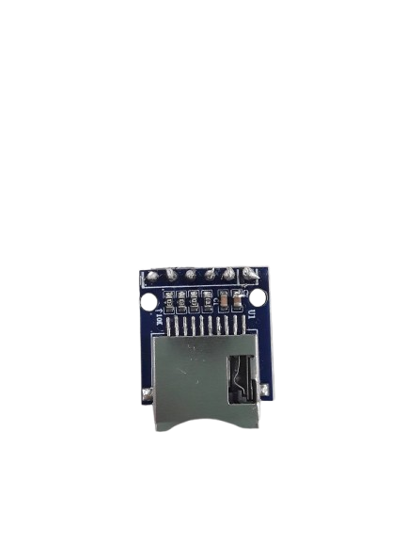
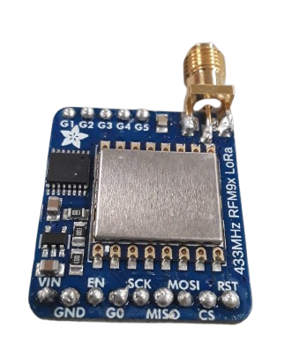
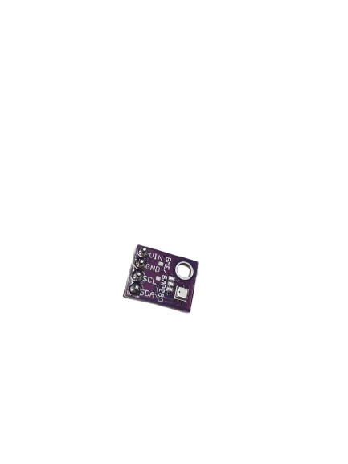
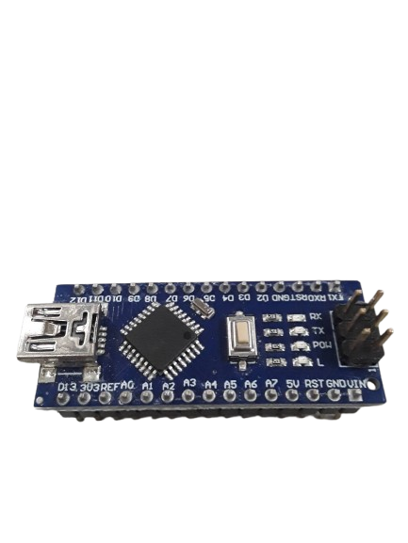
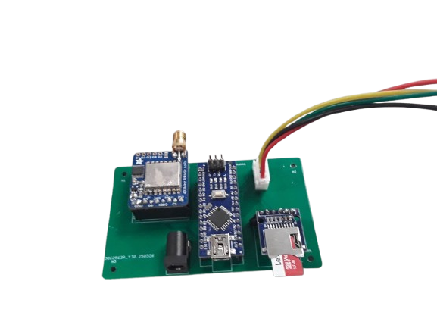
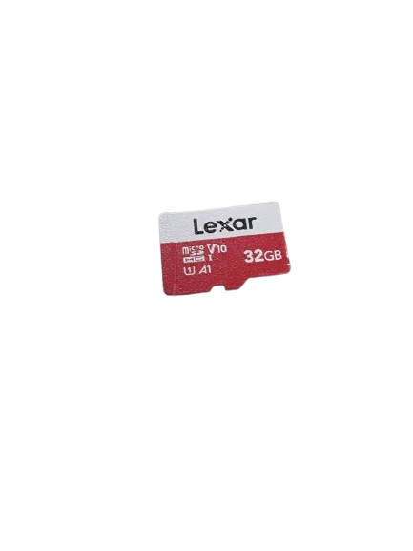
Methods Used - Materials
Arduino Nano
The brain
LoRa module
The radio
BME280 Sensor
Temperature, pressure, and humidity sensor
PCB
Used for mounting and connecting electronic components.
SD module
Facilitate electrical connections between components and the perfboard.
SD Card
Facilitate electrical connections between components and the perfboard.

Slide 6
Analysis
These are some outcomes that could happen.
Balloon station receives the message sent from the ground station, stores it, sends a response, but is not received by the ground station
Balloon station receives the message sent from the ground station, stores it, sends a response, and is received by the ground station
Balloon station doesn’t receive the message sent by the ground station

Slide 7
Sources
https://learn.adafruit.com/adafruit-rfm69hcw-and-rfm96-rfm95-rfm98-lora-packet-padio-breakouts/rfm9x-test
https://www.adafruit.com/product/3073

